Slide 1

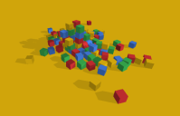
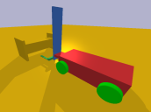
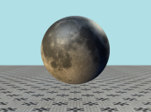
Introduction to Bullet Physics
Ian Parberry
Dept. of Computer Science & Engineering
University of North Texas

Slide 2
Bullet Physics
Bullet Physics is like a “grown up” version of Box2D.
It’s in 3D, not 2D. Most of the generalizations are pretty straightforward.
There is no concept of a “fixture”.
Bullet Physics is not so good at cleaning after itself. You must explicitly get rid of all bodies, shapes etc. before deleting Physics World.

Slide 3
From the User Manual
“Bullet Physics is a professional open source collision detection, rigid body and soft body dynamics library written in portable C++. The library is primarily designed for use in games, visual effects and robotic simulation. The library is free for commercial use under the ZLib license.”

Slide 4
Main Features
Discrete and continuous collision detection including ray and convex sweep test. Collision shapes include concave and convex meshes and all basic primitives
Maximal coordinate 6-degree of freedom rigid bodies (btRigidBody) connected by constraints (btTypedConstraint) as well as generalized coordinate multi-bodies (btMultiBody) connected by mobilizers using the articulated body algorithm.
Fast and stable rigid body dynamics constraint solver, vehicle dynamics, character controller and slider, hinge, generic 6DOF and cone twist constraint for ragdolls
Soft Body dynamics for cloth, rope and deformable volumes with two-way interaction with rigid bodies, including constraint support

Slide 5
Main Features
Open source C++ code under Zlib license and free for any commercial use on all platforms including PLAYSTATION 3, XBox 360, Wii, PC, Linux, Mac OSX, Android and iPhone
Maya Dynamica plugin, Blender integration, native binary .bullet serialization and examples how to import URDF, Wavefront .obj and Quake .bsp files.
Many examples showing how to use the SDK. All examples are easy to browse in the OpenGL 3 example browser. Each example can also be compiled without graphics.
Quickstart Guide, Doxygen documentation, wiki and forum complement the examples.

Slide 6










Where was it Used?

Slide 7
Where Do You Get It?
https://github.com/bulletphysics/bullet3
There is a Visual Studio 2010 solution file.
Open it in Visual Studio and let it update the projects.
There are 67 projects, not all of which will be needed.
It will compile right out of the box (except for one project).
When you compile and run it, you get a demo browser.
It has a manual and a lot of source code examples.
We will use 3 of the libraries (collision, dynamics, and math).
However, there are a couple of things to take care of before we can use it with the LARC Engine.

Slide 8
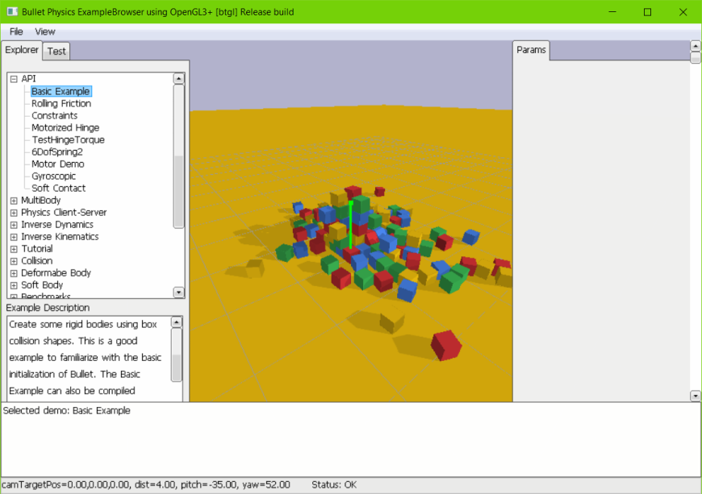

Slide 9
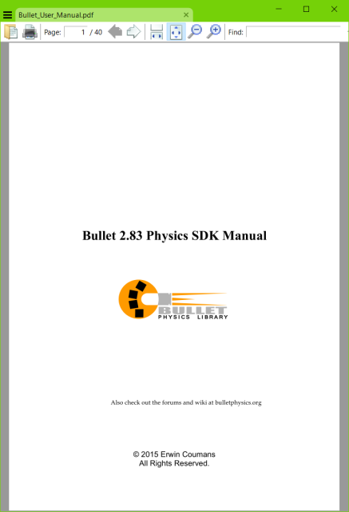
There is a Manual

Slide 10
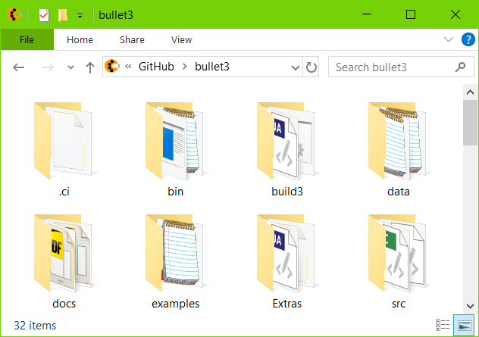
Adding Bullet Physics to your Code
Set environment variable $(BULLET_DIR) to your Bullet Physics install folder.

Slide 11
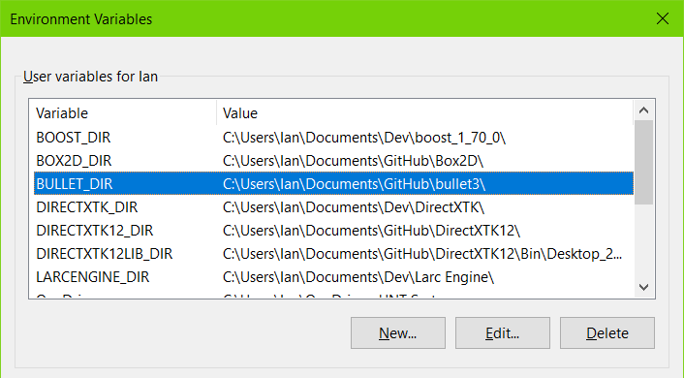

Slide 12
Adding Bullet Physics to your Code
Add the include path: $(BULLET_DIR)src
Add the library path: $(BULLET_DIR)bin
Add the 3 libraries
x_vs2010_$(Platform)_$(Configuration).lib
where x is
BulletCollision
BulletDynamics
LinearMath

Slide 13
Compile Time Errors
If you compile Bullet Physics out of the box and then attempt to link it to your game, then you will see the following error.
BulletCollision_vs2010_x64_Release.lib(btDefaultCollisionConfiguration.obj) : error LNK2038: mismatch detected for 'RuntimeLibrary': value 'MT_StaticRelease' doesn't match value 'MD_DynamicRelease' in Camera.obj

Slide 14
Here’s How You Fix That
In Visual Studio, select all of the projects in 0_Bullet3Solution.sln (click on the first, scroll down, click on the last).
Right-click on one of them and select Properties.
Navigate to C/C++\Code Generation and make the following changes.
Then compile all projects. A couple of them may fail but they are not important.

Slide 15
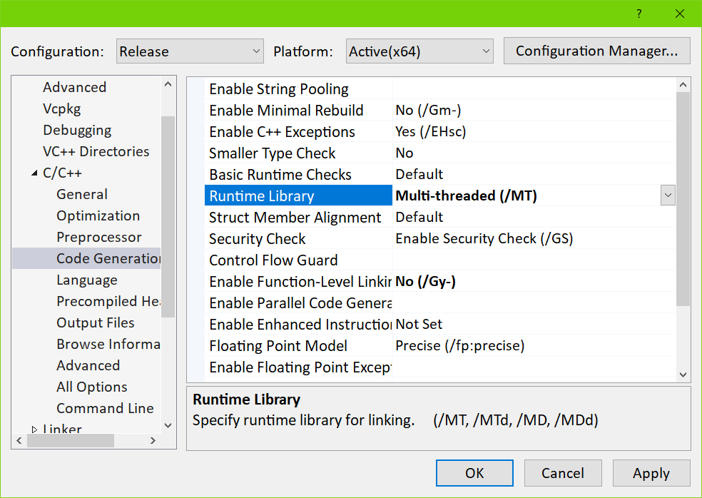

Slide 16
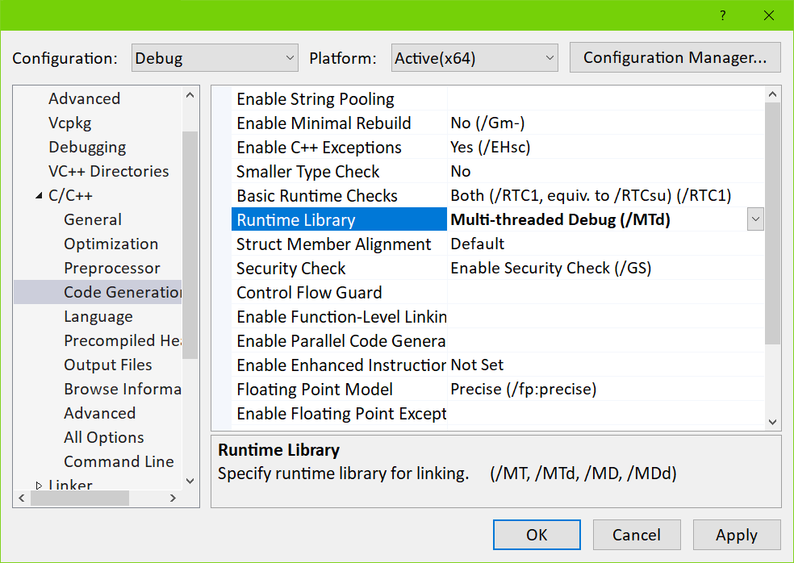

Slide 17
Precision Errors
Bullet Physics scalar type btScalar can be either float or double. Defining BT_USE_DOUBLE_PRECISION makes it double.
We want it to be float to be consistent with the rest of our code.
Unfortunately, you won’t find a #define for it, even though it is set to 1.
It’s set in the Visual Studio project settings in all projects. You will need to remove it.

Slide 18
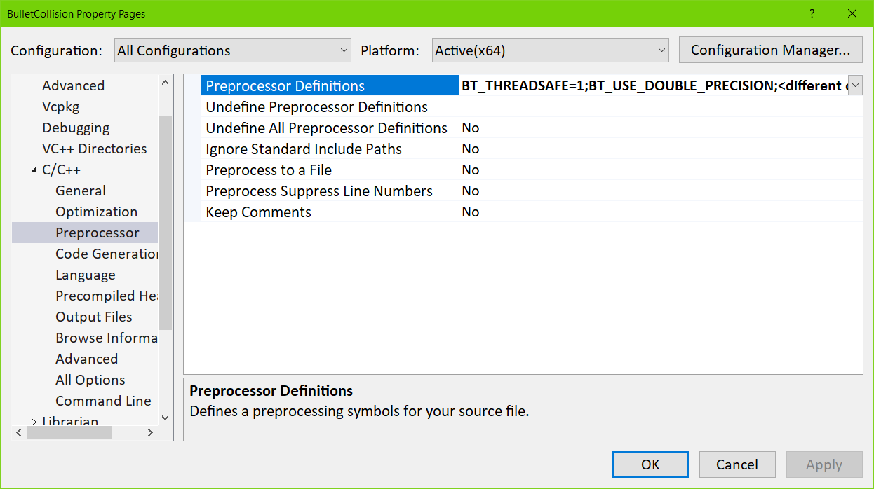

Slide 19
Bullet Physics Core Objects
class CCommon{
protected:
//etc.
static btDiscreteDynamicsWorld* m_pPhysicsWorld;
static btDefaultCollisionConfiguration* m_pConfig;
static btCollisionDispatcher* m_pDispatcher;
static btBroadphaseInterface* m_pBroadphase;
static btSequentialImpulseConstraintSolver* m_pSolver;
static btAlignedObjectArray<btCollisionShape*>
m_btCollisionShapes;
}; //CCommon

Slide 20
Initialize Bullet Physics
#include "btBulletDynamicsCommon.h"
void CGame::InitBulletPhysics(){
m_pConfig = new btDefaultCollisionConfiguration();
m_pDispatcher = new btCollisionDispatcher(m_pConfig);
m_pBroadphase = new btDbvtBroadphase();
m_pSolver = new btSequentialImpulseConstraintSolver;
m_pPhysicsWorld = new btDiscreteDynamicsWorld(
m_pDispatcher, m_pBroadphase, m_pSolver, m_pConfig);
m_pPhysicsWorld->setGravity(btVector3(0, -10, 0));
} //InitBulletPhysics

Slide 21
Adding Bodies
Create a btRigidBody and add it to the btDynamicsWorld. To construct a btRigidBody or btCollisionObject, you need to provide:
Mass, positive for dynamic moving objects and zero for static objects
A btCollisionShape, like a Box, Sphere, Cone, Convex Hull or Triangle Mesh
Material properties like friction and restitution

Slide 22
Adding a Rigid Body
btCollisionShape* pShape = new btSphereShape(RW2PW(r));
m_btCollisionShapes.push_back(pShape);
btTransform trans;
trans.setIdentity();
trans.setOrigin(RW2PW(pos));
btScalar mass = 1.2f;
btVector3 inertia(0, 0, 0);
pShape->calculateLocalInertia(mass, inertia);
btDefaultMotionState* pDms = new btDefaultMotionState(trans);
btRigidBody::btRigidBodyConstructionInfo
rbInfo(mass, pDms, pShape, inertia);
m_pBody = new btRigidBody(rbInfo);
m_pBody->setRestitution(0.9f);
m_pBody->setFriction(0.5f);
m_pPhysicsWorld->addRigidBody(m_pBody);

Slide 23
Frame Update
Once a frame, call stepSimulation on the dynamics world.
The btDiscreteDynamicsWorld automatically takes into account variable timestep by performing interpolation instead of simulation for small timesteps.
It uses an internal fixed timestep of 60 Hertz.
stepSimulation will perform collision detection and physics simulation.
It updates the world transform for active objects by calling the btMotionState’s setWorldTransform.

Slide 24
Rigid Body Dynamics
Rigid body dynamics is implemented on top of the collision detection module. It adds forces, mass, inertia, velocity and constraints.
btRigidBody is the main rigid body object.
Moving objects have non-zero mass and inertia.
btRigidBody is derived from btCollisionObject, so it inherits its world transform, friction and restitution, and adds linear and angular velocity.
btTypedConstraint is the base class for rigid body constraints, including
btHingeConstraint,
btPoint2PointConstraint,
btConeTwistConstraint,
btSliderConstraint, and
btGeneric6DOFConstraint.

Slide 25
Rigid Body Types
There are 3 different types of rigid bodies in Bullet:
Dynamic (moving) rigid bodies
positive mass
every simulation frame it will update its world transform
Static rigid bodies
zero mass
cannot move but can collide
Kinematic rigid bodies
zero mass
can be animated by the user, but there will be only one-way interaction: dynamic objects will be pushed away, but there is no influence from them.

Slide 26
Center of Mass
The world transform of a rigid body is in Bullet always equal to its center of mass, and its basis also defines its local frame for inertia.
The local inertia tensor depends on the shape, and the btCollisionShape class provides a method to calculate the local inertia, given a mass.
This world transform has to be a rigid body transform, which means it should contain no scaling, shear etc.
If the collision shape is not aligned with the center of mass transform, it can be shifted to match with a btCompoundShape, using the child transform to shift the child collision shape.

Slide 27
MotionState
MotionStates are a way for Bullet to get the world transform of objects being simulated into the rendering part of your game.
Your game loop will iterate through all the objects before each frame render. For each object, update the position of the render object from the physics body using MotionStates.
Other benefits of MotionStates:
Computation involved in moving bodies around is only done for bodies that have moved.
You don't just have to do render stuff in them. They could be effective for notifying network code that a body has moved and needs to be updated across the network.
Interpolation is usually only meaningful in the context of something visible on-screen. Bullet manages body interpolation through MotionStates.

Slide 28
MotionState
MotionStates are used in two places in Bullet.
When the body is first created. Bullet:
Grabs the initial position of the body from the MotionState when the body enters the simulation
Calls getWorldTransform with a reference to the variable it wants you to fill with transform information
Calls getWorldTransform on kinematic bodies.
After the first update, during simulation. Bullet calls the MotionState for a body to move it around
Bullet calls setWorldTransform with the transform of the body, for you to update your object appropriately
To implement one, simply inherit MotionState and override getWorldTransform and setWorldTransform.

Slide 29
btDefaultMotionState
Although recommended, it is not necessary to derive your own MotionState from btMotionState interface.
Bullet provides a default MotionState that you can use for this. Simply construct it with the default transform of your body:
btDefaultMotionState* pDms = new
btDefaultMotionState();

Slide 30
Render Frames and Physics Frames
By default, Bullet physics simulation runs at an internal fixed frame rate of 60 Hertz. Your render loop will have a different or even variable frame rate. To decouple the render frame rate from the simulation frame rate, an automatic interpolation method is built into stepSimulation:
If the application delta time is smaller then the internal fixed time step, Bullet will interpolate the world transform and send it to the btMotionState, without performing physics simulation.
If the application time step is larger than 60Hz, one or more simulation steps can be performed during each stepSimulation call. The user can limit the maximum number of simulation steps by passing a maximum value as second argument.

Slide 31
The Bullet Physics Block Toy

Slide 32
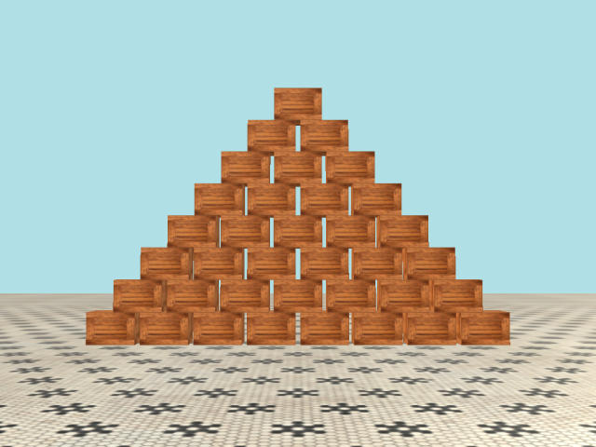
The Bullet Physics Block Toy

Slide 33
Controls
The aim is to knock things off the plane by firing soccer balls.
Space to fire a ball along the view vector.
Arrow keys to orient the camera.
WASD to move the camera (relative to the view vector).
Backspace to restart.

Slide 34
PW2RW
inline float PW2RW(btScalar x){return float(x)*fPRV;};
inline Vector3 PW2RW(const btVector3& v){
return Vector3(v.getX(), v.getY(), v.getZ())*fPRV;
}; //PW2RW
inline Quaternion PW2RW(const btQuaternion& q){
return Quaternion(q.x(), q.y(), q.z(), q.w());
}; //PW2RW

Slide 35
CObject::GetPosition() CObject::GetOrientation()
const Vector3 CObject::GetPosition() const{
if(!m_pBody || !m_pBody->getMotionState())
return Vector3::Zero;
btTransform trans;
m_pBody->getMotionState()->getWorldTransform(trans);
return PW2RW(trans.getOrigin());
} //GetPosition
const Quaternion CObject::GetOrientation() const{
if(!m_pBody || !m_pBody->getMotionState())
return Quaternion::Identity;
btTransform trans;
m_pBody->getMotionState()->getWorldTransform(trans);
return PW2RW(trans.getRotation());
} //GetOrientation

Slide 36
CObjectManager::update()
void CObjectManager::update(){
for(auto& p: m_stdObjectList){
if(p->GetPosition().y < -32.0f)
p->kill();
CullDeadObjects();
} //update

Slide 37
CGame::ProcessFrame()
void CGame::ProcessFrame(){
ControllerHandler();
KeyboardHandler();
m_pAudio->BeginFrame();
m_pStepTimer->Tick([&](){
m_pPhysicsWorld->stepSimulation(
m_pStepTimer->GetElapsedSeconds(), 4);
m_pObjectManager->update();
});
RenderFrame();
} //ProcessFrame

Slide 38
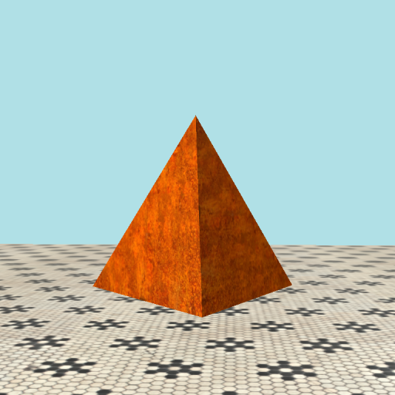
The Regular Tetrahedron

Slide 39
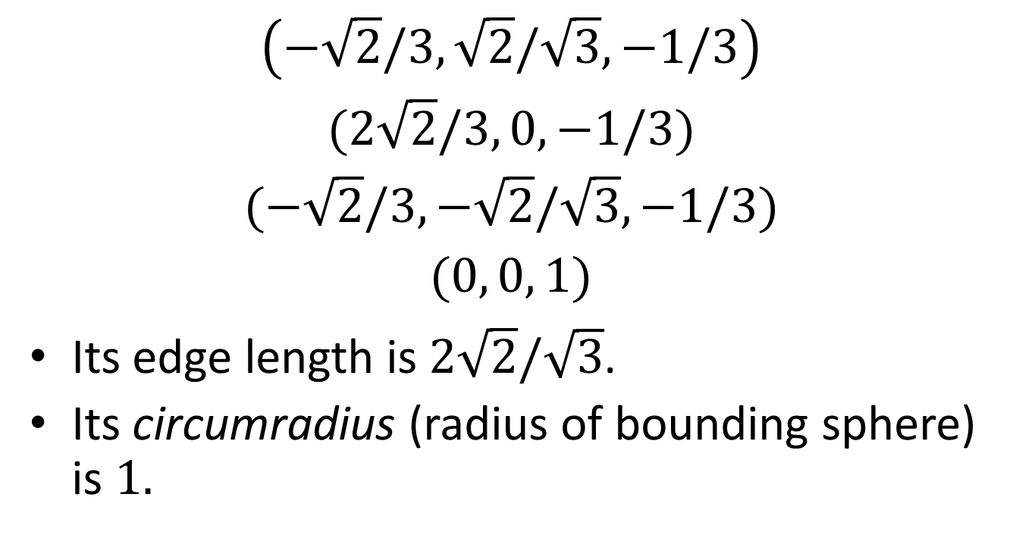
Cartesian Coordinates of the Vertices of a Regular Tetrahedron
$$\left(−\sqrt{2}/3,\sqrt{2}/\sqrt{3},−1/3\right)$$
$$(2\sqrt{2}/3, 0, −1/3)$$
$$(−\sqrt{2}/3,−\sqrt{2}/\sqrt{3},−1/3)$$
$$(0, 0, 1)$$
Its edge length is $2\sqrt{2}/\sqrt{3}$.
Its circumradius (radius of bounding sphere) is $1.$

Slide 40
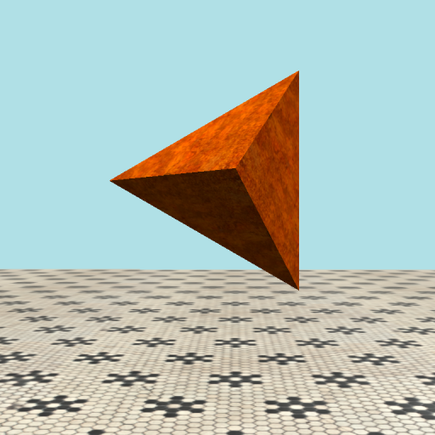
The Tetrahedron Mesh
GeometricPrimitive::CreateTetrahedron from DirectXTK12 creates a tetrahedron using this method.
It is created at an awkward angle.

Slide 41
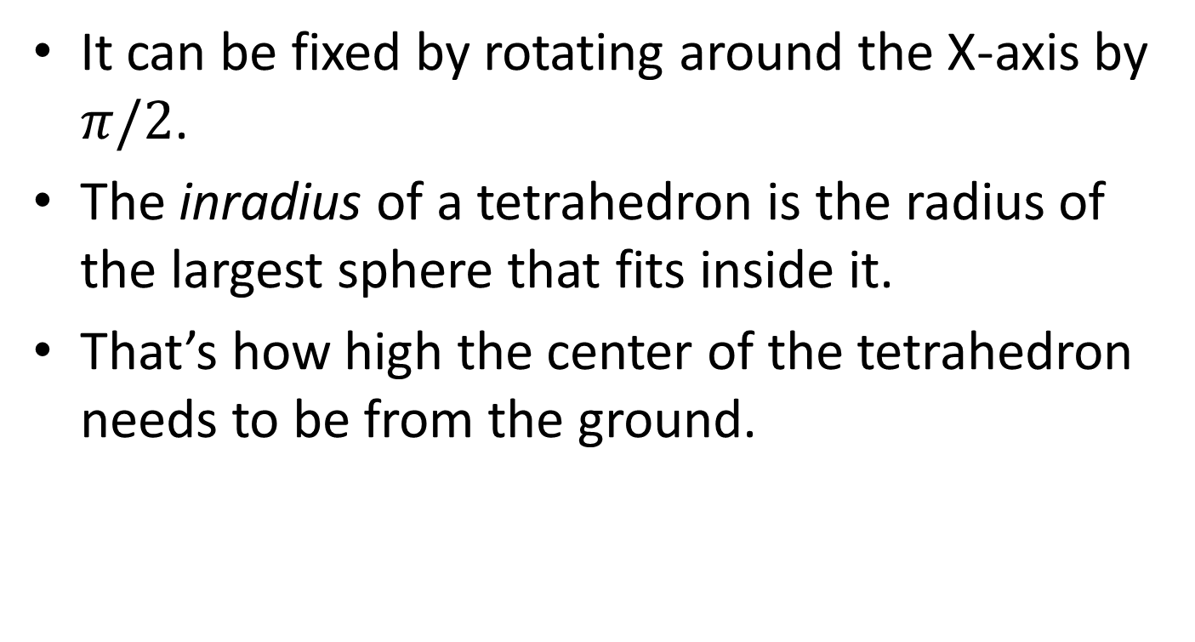
Tetrahedron Orientation and Position
It can be fixed by rotating around the X-axis by $π/2$.
The inradius of a tetrahedron is the radius of the largest sphere that fits inside it.
That’s how high the center of the tetrahedron needs to be from the ground.

Slide 42
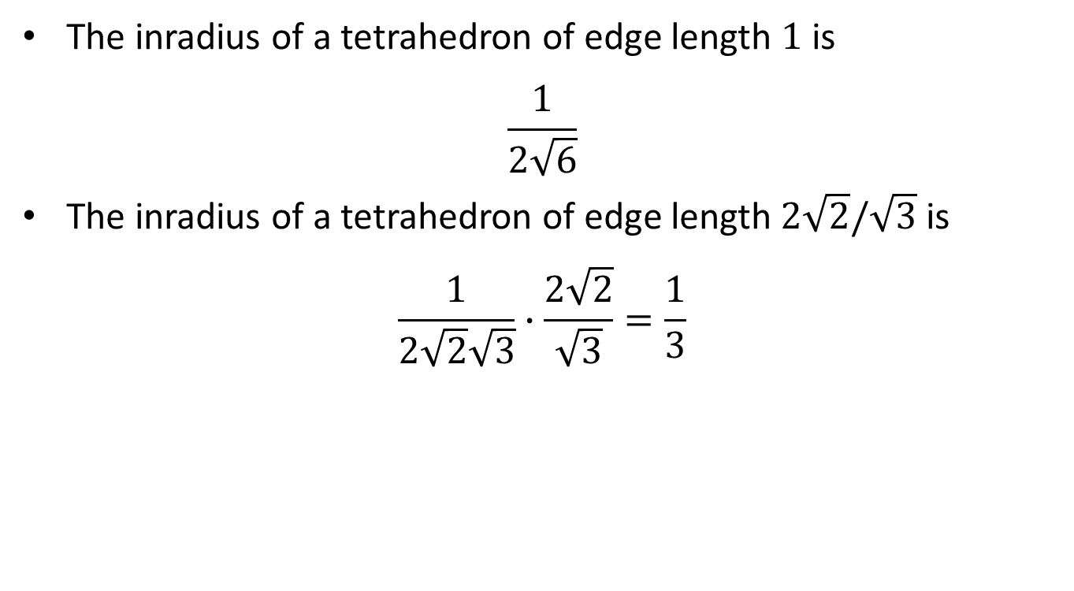
Tetrahedron Position
The inradius of a tetrahedron of edge length $1$ is
$$\frac{1}{2\sqrt{6}}$$
The inradius of a tetrahedron of edge length$2\sqrt{2}/\sqrt{3}$ is
$$\frac{1}{2\sqrt{2}\sqrt{3}}∙\frac{2\sqrt{2}}{\sqrt{3}}=\frac{1}{3}$$

Slide 43
Tetrahedron Instance Descriptor
CInstanceDesc d; //instance descriptor
d.m_eMeshType = eMeshType::Tetrahedron;
d.m_fScale = m_fTetrahedronSize;
d.m_vPos = Vector3(0, d.m_fScale/3 + m_fFloorHt, -100);
d.m_qOrientation = Quaternion::CreateFromAxisAngle(
Vector3::UnitX, -XM_PIDIV2);
d.m_fMass = 3.0f;
d.m_fRestitution = 0.5f;
d.m_fFriction = 0.7f;

Slide 44
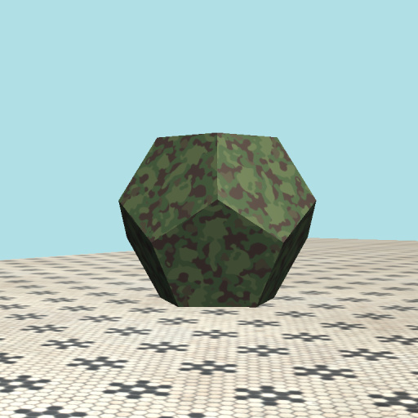
The Regular Dodecahedron

Slide 45
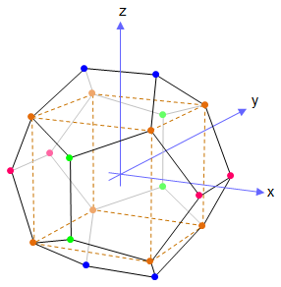
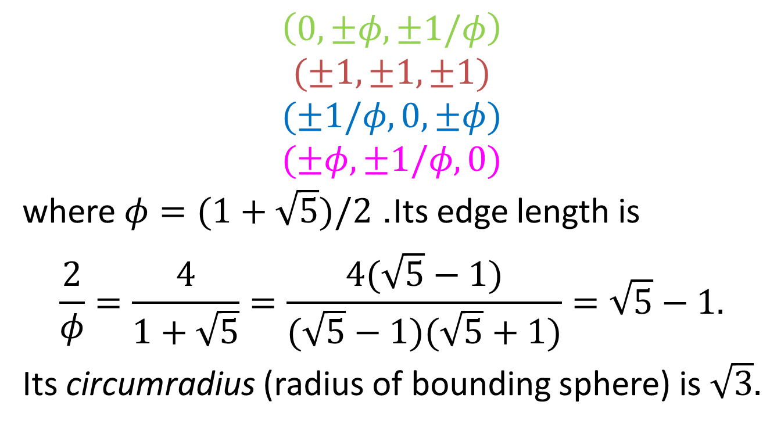
Cartesian Coordinates of the Vertices of a Regular Dodecahedron
$$\left(0, ±φ,±1/φ\right)$$
$$(±1, ±1,±1)$$
$$(±1/φ, 0,±φ)$$
$$(±φ, ±1/φ,0)$$
where $φ=(1+\sqrt{5})/2$. Its edge length is
$$\frac{2}{φ}=\frac{4}{1+\sqrt{5}}=\frac{4(\sqrt{5}−1)}{(\sqrt{5}−1)(\sqrt{5}+1)}=\sqrt{5}−1.$$
Its circumradius (radius of bounding sphere) is $\sqrt{3}.$

Slide 46
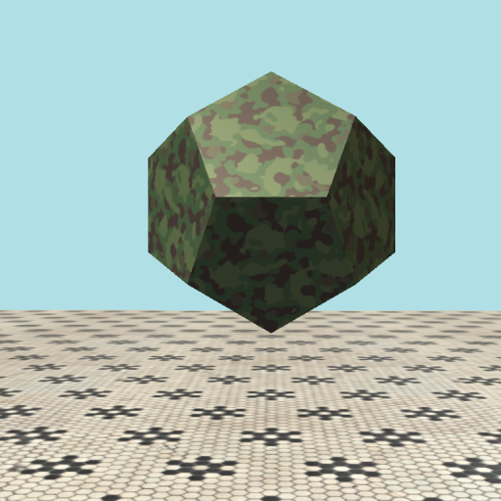
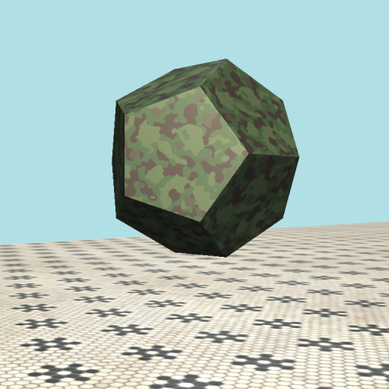
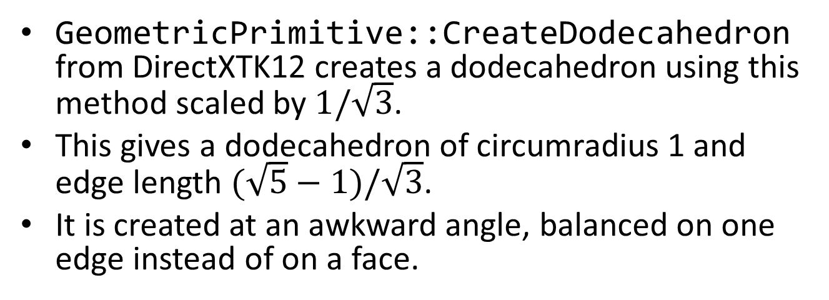
The Dodecahedron Mesh
GeometricPrimitive::CreateDodecahedron from DirectXTK12 creates a dodecahedron using this method scaled by $1/\sqrt{3}$.
This gives a dodecahedron of circumradius 1 and edge length $(\sqrt{5}−1)/\sqrt{3}$.
It is created at an awkward angle, balanced on one edge instead of on a face.

Slide 47
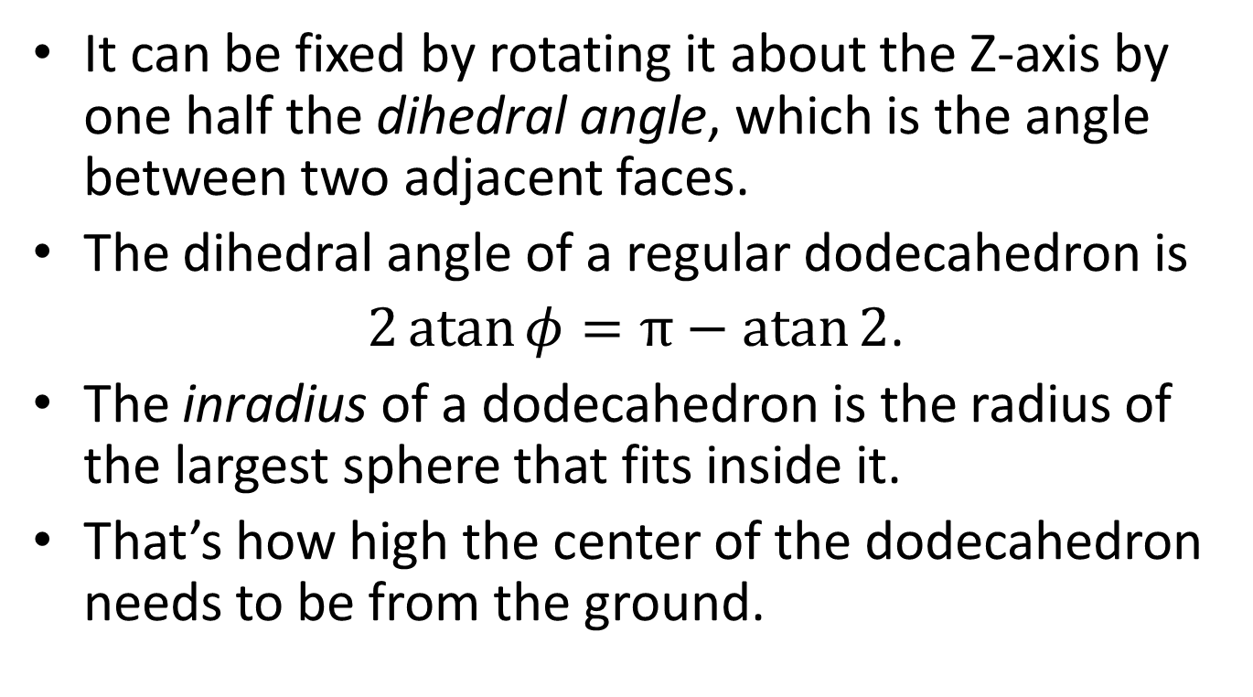
Dodecahedron Orientation and Position
It can be fixed by rotating it about the Z-axis by one half the dihedral angle, which is the angle between two adjacent faces.
The dihedral angle of a regular dodecahedron is
$2\operatorname{atan}{φ}=π−\operatorname{atan}{2}$.
The inradius of a dodecahedron is the radius of the largest sphere that fits inside it.
That’s how high the center of the dodecahedron needs to be from the ground.

Slide 48
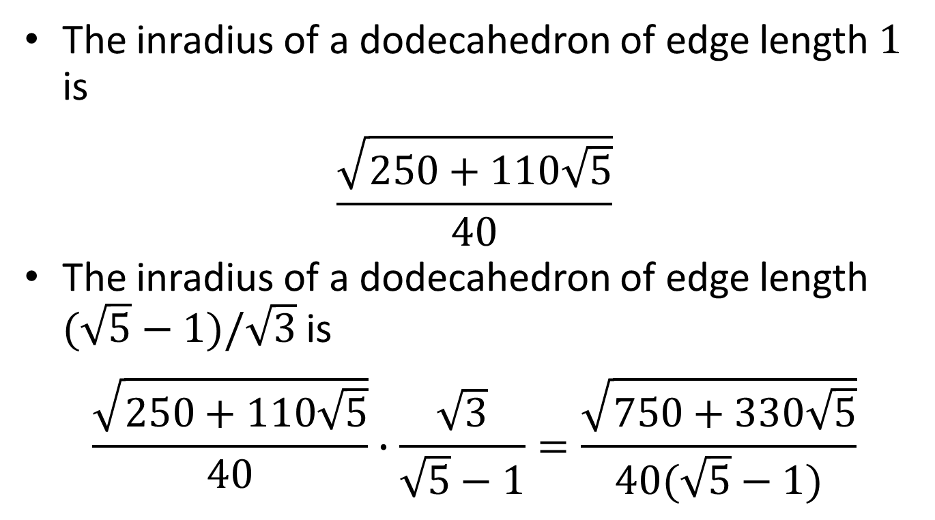
Dodecahedron Position
The inradius of a dodecahedron of edge length $1$ is
$$\frac{\sqrt{250+110\sqrt{5}}}{40}$$
The inradius of a dodecahedron of edge length $(\sqrt{5}−1)/\sqrt{3}$ is
$$\frac{\sqrt{250+110\sqrt{5}}}{40}∙\frac{\sqrt{3}}{\sqrt{5}−1}=\frac{\sqrt{750+330\sqrt{5}}}{40(\sqrt{5}−1)}$$

Slide 49
Dodecahedron Instance Descriptor
CInstanceDesc d; //instance descriptor
d.m_eMeshType = eMeshType::Dodecahedron;
d.m_fScale = m_fDodecahedronSize;
const float SQRT5 = sqrtf(5.0f);
const float r = d.m_fScale*sqrtf(750.0f +
330.0f*SQRT5)/(40.0f*(SQRT5 - 1.0f));
d.m_vPos = Vector3(-80.0f, r + m_fFloorHt, -100.0f);
const float da = XM_PI - atanf(2.0f); //dihedral angle
d.m_qOrientation = Quaternion::CreateFromAxisAngle(
Vector3::UnitZ, da/2.0f);
d.m_fMass = 3.0f;
d.m_fRestitution = 0.6f;
d.m_fFriction = 0.6f;

Slide 50
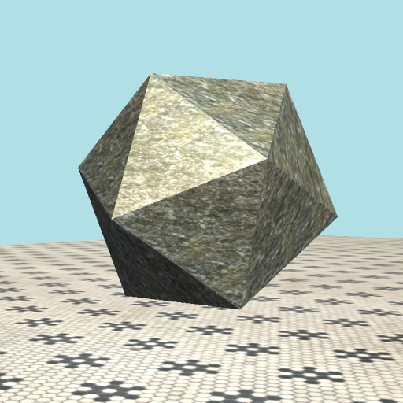
The Regular Icosahedron

Slide 51
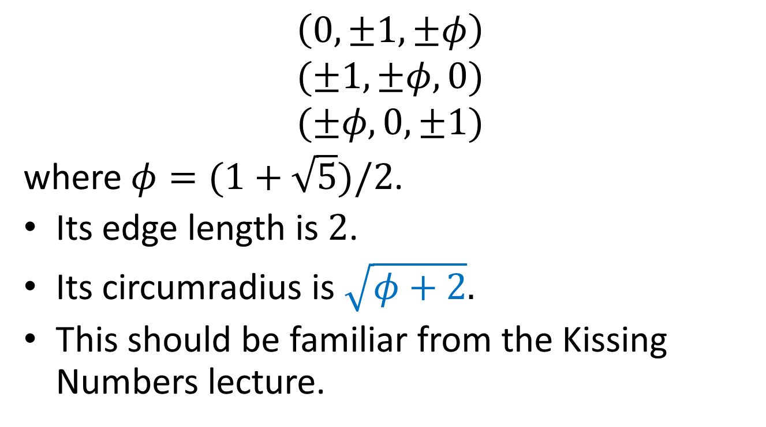
Cartesian Coordinates of the Vertices of a Regular Icosahedron
$$\left(0, ±1,±φ\right)$$
$$(±1, ±φ,0)$$
$$(±φ, 0,±1)$$
where $φ=(1+\sqrt{5})/2$.
Its edge length is $2$.
Its circumradius is $\sqrt{φ+2}.$
This should be familiar from the Kissing Numbers lecture.

Slide 52
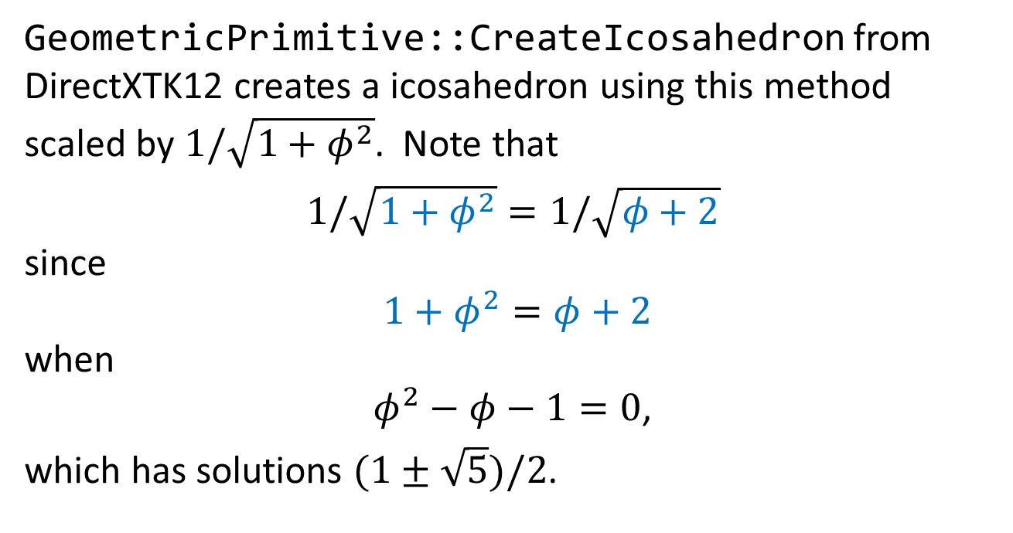
The Icosahedron Mesh
GeometricPrimitive::CreateIcosahedron from DirectXTK12 creates a icosahedron using this method scaled by $1/\sqrt{1+φ^{2}}$. Note that
$1/\sqrt{1+φ^{2}}=1/\sqrt{φ+2}$
since
$1+φ^{2}=φ+2$
when
$φ^{2}−φ−1=0$,
which has solutions $(1±\sqrt{5})/2$.

Slide 53
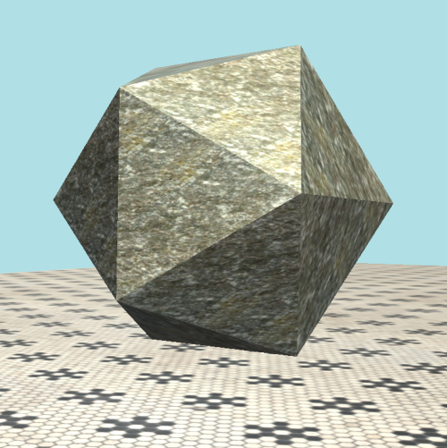
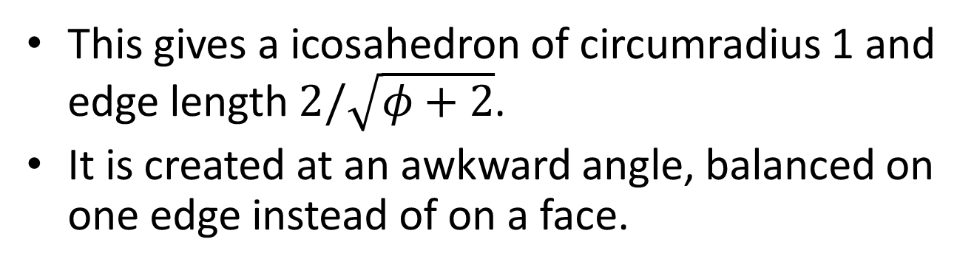
The Icosahedron Mesh
This gives a icosahedron of circumradius 1 and edge length $2/\sqrt{φ+2}$.
It is created at an awkward angle, balanced on one edge instead of on a face.

Slide 54
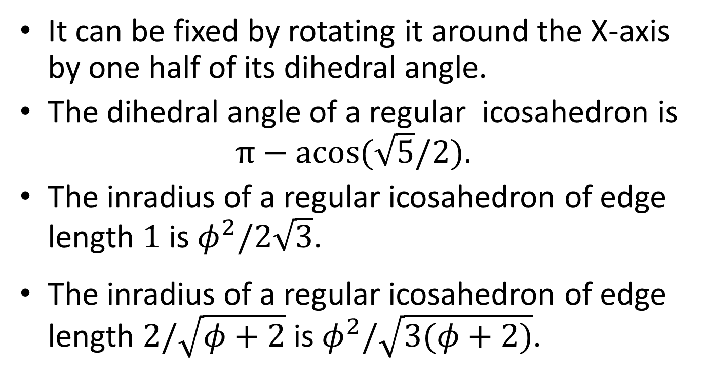
Icosahedron Orientation and Position
It can be fixed by rotating it around the X-axis by one half of its dihedral angle.
The dihedral angle of a regular icosahedron is
$π−\operatorname{acos}{(\sqrt{5}/2)}$.
The inradius of a regular icosahedron of edge length $1$ is $φ^{2}/2\sqrt{3}$.
The inradius of a regular icosahedron of edge length $2/\sqrt{φ+2}$ is $φ^{2}/\sqrt{3(φ+2)}$.

Slide 55
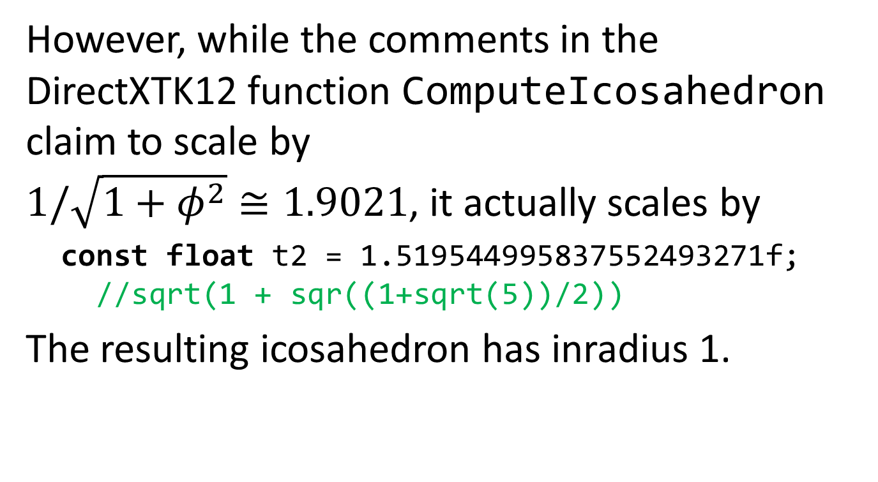
DirectXTK12 Bug?
However, while the comments in the DirectXTK12 function ComputeIcosahedron claim to scale by
$1/\sqrt{1+φ^{2}}≅1.9021$, it actually scales by
const float t2 = 1.519544995837552493271f;
//sqrt(1 + sqr((1+sqrt(5))/2))
The resulting icosahedron has inradius 1.

Slide 56
Icosahedron Instance Descriptor
CInstanceDesc d; //instance descriptor
d.m_eMeshType = eMeshType::Icosahedron;
d.m_fScale = m_fIcosahedronSize;
d.m_vPos = Vector3(-120, d.m_fScale + m_fFloorHt, -100);
const float ida = XM_PI - acosf(SQRT5/3); //dihedral angle
d.m_qOrientation = Quaternion::CreateFromAxisAngle(
Vector3::UnitX, ida/2.0f);
d.m_fMass = 3.0f;
d.m_fRestitution = 1.0f;
d.m_fFriction = 0.9f;

Slide 57
Sound Using Bullet Callbacks

Slide 58
Contact Descriptor
class CContactDesc{
public:
UINT m_nNumContacts = 0 ;
float m_fImpulse = 0.0f;
CContactDesc();
CContactDesc(const UINT, const float=0.0f);
}; //CContactDesc

Slide 59
Contact Callback
m_pPhysicsWorld->setInternalTickCallback(myTickCallback);
void myTickCallback(btDynamicsWorld *p, btScalar t){
UNREFERENCED_PARAMETER(t);
const UINT nManifolds =
(UINT)p->getDispatcher()->getNumManifolds();
for(UINT i=0; i<nManifolds; i++){
btDispatcher* pDispatcher = p->getDispatcher();
btPersistentManifold* pManifold =
pDispatcher->getManifoldByIndexInternal(i);
const btRigidBody* pBody0 =
btRigidBody::upcast(pManifold->getBody0());
const btRigidBody* pBody1 =
btRigidBody::upcast(pManifold->getBody1());

Slide 60
Contact Callback
CObject* pObj0 = (CObject*)pBody0->getUserPointer();
CObject* pObj1 = (CObject*)pBody1->getUserPointer();
const int nContacts = pManifold->getNumContacts();
if(pObj0 && pObj1 && nContacts > 0){
CContactDesc d(nContacts);
for(int j=0; j<nContacts; j++){
btManifoldPoint& pt = pManifold->getContactPoint(j);
d.m_fImpulse =
std::max(d.m_fImpulse, pt.getAppliedImpulse());
} //for
pObj0->AddContact(pObj1, d);
} //if
} //for
} //myTickCallback

Slide 61
Add Contact
class CObject{
private:
std::map<CObject*, CContactDesc> m_mapContact[2];
UINT m_nContactIndex = 0;
}; //CObject
void CObject::AddContact(CObject* pObj,
const CContactDesc& d)
{
m_mapContact[m_nContactIndex].insert(
std::pair<CObject*, CContactDesc>(pObj, d));
} //AddContact

Slide 62
Play Collision Sound
void CObject::PlayCollisionSounds(){
std::map<CObject*, CContactDesc>& mapCurr =
m_mapContact[m_nContactIndex];
std::map<CObject*, CContactDesc>& mapPrev =
m_mapContact[m_nContactIndex^1];
if(!m_bCollisionSoundsMuted)
for(const auto& contactCurr: mapCurr){
CObject* pObj = contactCurr.first; object
const CContactDesc dCurr = contactCurr.second;
auto contactPrev = mapPrev.find(pObj);
CContactDesc dPrev;
if(contactPrev != mapPrev.end())
dPrev = contactPrev->second;

Slide 63
Play Collision Sound
if(contactPrev == mapPrev.end() ||
dCurr.m_nNumContacts > dPrev.m_nNumContacts)
{
const float volume = 0.05f*dCurr.m_fImpulse;
const Vector3 vPos = GetPosition();
if(volume > 0.1f){
//play the appropriate sound based on object types
} //if
} //if
} //for
m_nContactIndex = m_nContactIndex^1;
m_mapContact[m_nContactIndex].clear();
} //PlayCollisionSounds

